Slide 1
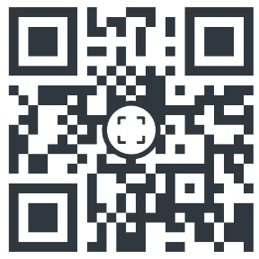
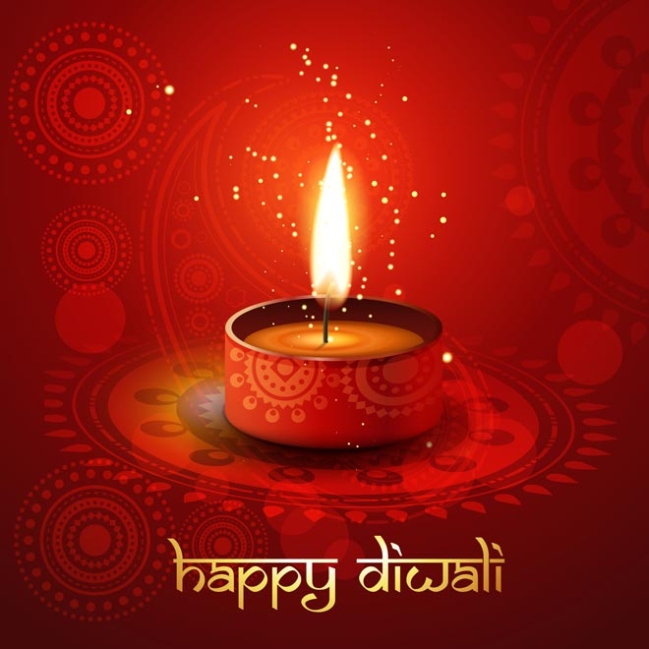
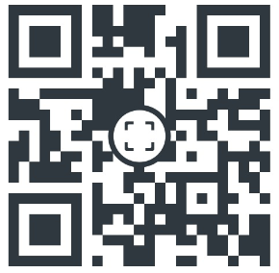
Diwali
Video
Story of Rama and Sita
Make your own Mendi
What do you know about Diwali?

