Slide 1
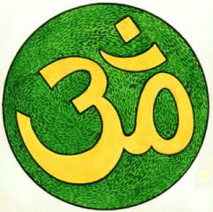
Hinduism

Slide 2
Origin
Estimated to have begun in the Indus Valley 2000BCE.
Developed more into what it is today in about 500BCE, known as the Vedas Period.
The term Hinduism is a C19th word.
Translates from sanskrit’s ‘Sindhu’, originating from the region near the Sindhu river.

Slide 3
Population
It is the third largest religion
800 million up in India that are Hindus (about 80% of the population)
820,000 Hindus estimated to be in Britain in 2011.

Slide 4
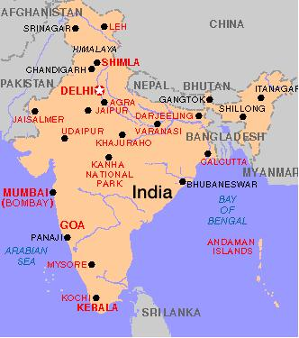
A Map of Hindu India

Slide 5
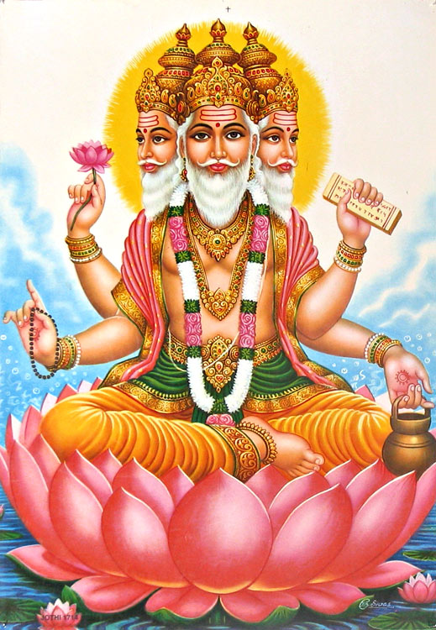
What Hindus Believe
Hindus believe in one God.
They believe God is everywhere and in everything.
The Supreme Soul is called Brahman.
Hindus believe that Brahman has many forms.
They believe that these forms represent the different aspects of Brahman’s power.
Many Hindus choose more than one of these deities to worship.
They believe in a rebirth cycle- judged by Karma.

Slide 6
Temple Worship.
Within a Hindu temple there are different sections which have a different spiritual or symbolic meaning.
The central shrine is the heart of the worshipper
The tower represents the flight of the spirit to heaven
A priest may read, or more usually recite, the Vedas to the assembled worshippers, but any "twice-born" Hindu can perform the reading of prayers and mantras.

Slide 7
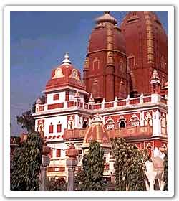
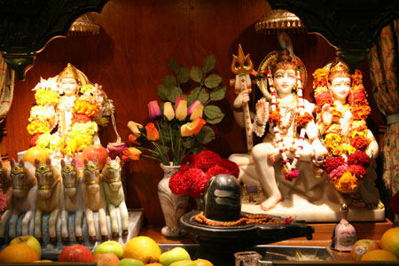
Mandir
The temple is a special place for Hindus.
It is known as the Mandir and is regarded as God’s home on Earth.
A murti is a deity or image of a Hindu god or goddess and are to be found in the Mandir.
The Murti is made according to the instructions of the shilpa shastra. The priest then installs them through the establishing of life ceremony – known as the prana pratistha.
They are treated as living beings and are washed, dressed and fed during the day.
Hindus visit the mandir for darshana, or a ‘sight’ of the deity.

Slide 8
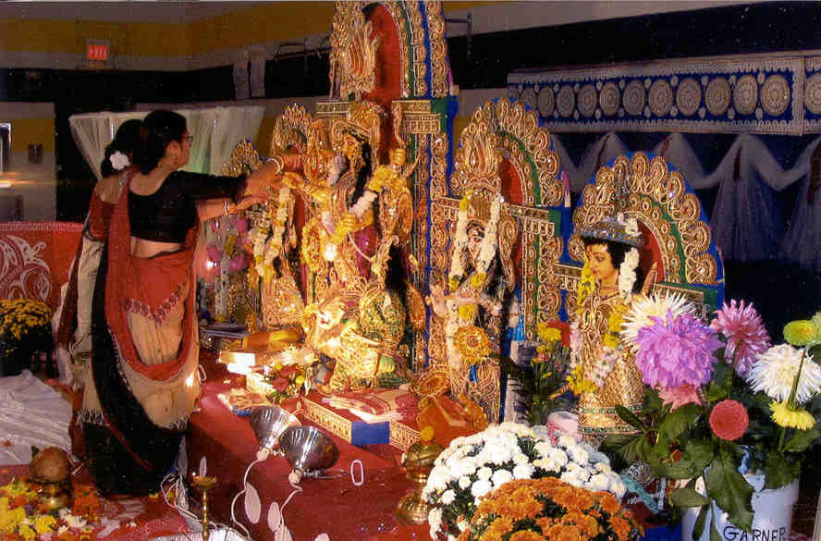
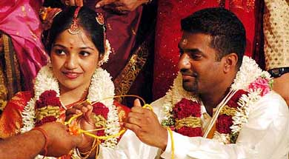
Puja
Puja is the name given to the Hindu act of worship.
Blessed sweets, flowers and fruit are offered to the Deity.
These are shared amongst the worshippers.
This bestows a blessing by God.
The priest who performs the puja in the Mandir is called a pujari
After puja, he places a red mark on the worshippers foreheads.
Hindu women wear a red mark on their foreheads to show that they are married.

Slide 9
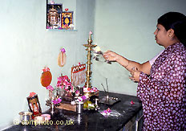
Home Worship
In many Hindu homes you will find a shrine
The shrines can differ from a whole room, a small altar or just pictures and statues of the deity.
Family members would sometimes worship together.
Rituals should take place three times a day.
Some Hindus worship wearing the sacred thread.
At the end of the puja a tray of five lamps is placed in front of the deity .
This is called ‘Aarti.

Slide 10
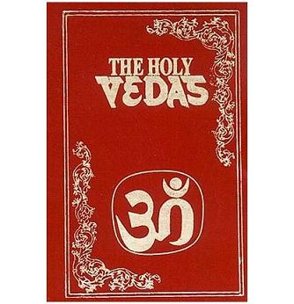
Holy Books
The main Hindu scriptures are:
the Vedas, a collection of hymns praising the Vedic gods. Veda means 'knowledge'
the Ramayana, long epic poems about Rama and Sita
the Mahabharata, which includes the Bhagavad Gita
the Puranas, a collection of stories about the different incarnations and the lives of saints.

Slide 11
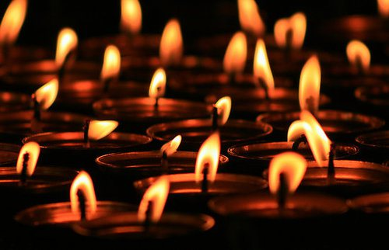
Diwali
Diwali literally means ‘rows of lighted lamps’
The festival of light
The ‘earthware’ lamps are known as Diyas.
Worship to Lakshmi, Goddess of Wealth. (Known by other names in other Hindu countries)
Marks the start of a New Hindu Year.
Celebrates the love story of Rama and Sita.
Good beating evil, light over dark.

Slide 12
Other festivals
Holi - the festival of colour
- marks the beginning of Spring
- celebrates Krishna
Navaratri (celebrating fertility and harvest)
Raksha Bandhan (celebrating the bond between brother and sister)
Janmashtami (Krishna's birthday)

Slide 13
Holi 2013

Slide 14
Hindu Diet
Many Hindus are believed to be vegetarian with some exceptions.
Hindu diet varies by region.
They believe the body is composed of the 4 elements.
Food can balance these elements or counterbalance them.

Slide 15
Hindu Food Categories
Sattvic
Rajasic
Tamasic

Slide 16
Meat in the Hindu Diet
Dairy products, fish and shellfish or poultry.
Pork
Very rarely, beef.

Slide 17
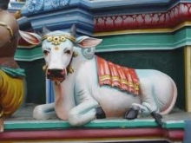
Beef
For many Hindus eating beef is considered sacrilegious.
It is common for the cow to be known as ‘The Mother’.

Slide 18
Female Clothing
The traditional costume of Hindu women in India is the sari.
This is a piece of brightly coloured material that is wound and pleated around the waist to cover the legs.
The end of the sari is draped over the shoulder on top.
In the UK, the older generation may still wear this costume, but younger Hindus are beginning to wear long trousers and tunic tops.

Slide 19
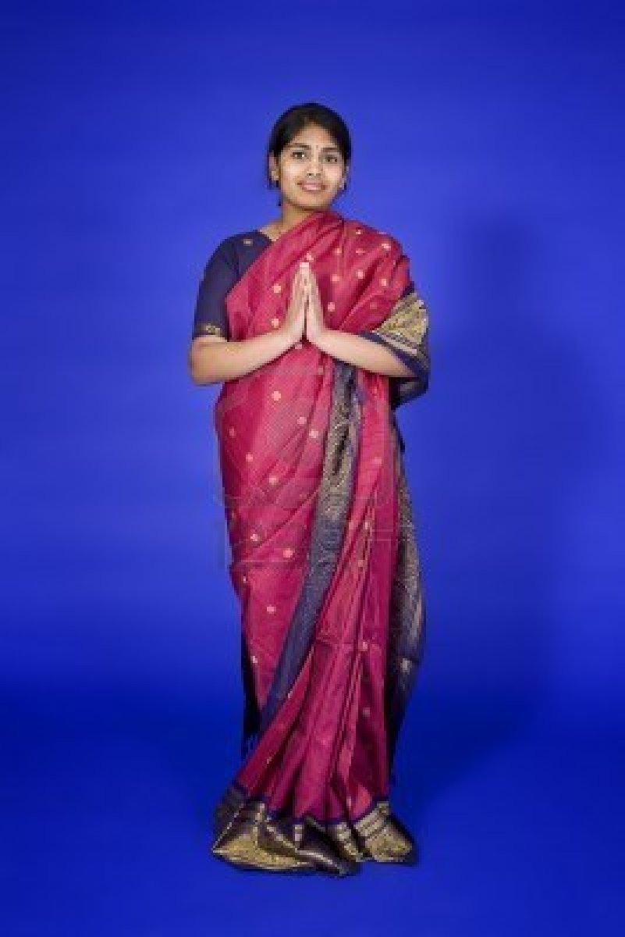
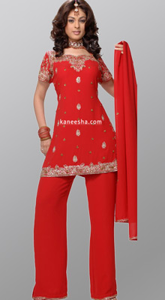
Traditional
Modern

Slide 20
Male Clothing
In the UK Hindu men generally wear western clothes.
The older generation may wear normal trousers and a long tunic top over them.
The traditional outfit is very similar; the tunic is a jacket with buttons down the front and a 'Nehru' collar, and the trousers are generally quite loose.

Slide 21
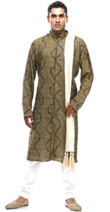
Modern
Traditional

Slide 22
Make-up
Hindu women wear a coloured spot on their forehead.
The mark is called a bhindi.
Traditionally, the red spot that is worn by married women was marked on a bride's forehead by the groom with his own blood.
Widows and some unmarried women may wear a black bhindi.
Young and unmarried women usually wear a bhindi that matches the colour of their outfit.

Slide 23
Henna
Hindus also practise henna body art for special occasions.
Intricate designs are traced onto their hands, arms and feet. Once the henna is washed off, the design remains as a tracery of fine ochre lines on the skin.
Henna is believed to ward off evil spirits.

Slide 24
