Slide 1
RECENT DEVELOPMENTS IN COPYRIGHT LAW AND WHAT THEY MEAN FOR YOU
Charles Oppenheim
Visiting Professor in LLS
LLS Conference, 5 July 2016

Slide 2
REMINDER OF THE BASICS

Slide 3
WHO IS THE OWNER?
Interesting question regarding who owns © in an employee-created work. It will normally be the employer when the work has been created as part of employee duties, or where the employer‘s explicit policy is to claim ownership of everything created by employees.
How does this apply to teaching materials created by a University employee? Arguably they ARE required to create them, so the University owns the © in them
What about research outputs? Does the University own the ©? Why then does it leave it to you to assign © to (say) a journal pubisher? Is it waiving © ownership, or just the handling of ©?

Slide 4
OWNERSHIP, ASSIGNMENT, LICENCES
The first owner of copyright (an individual, or their employer) can *choose* to assign (pass over ownership). Typically with journal articles, the © ownership is assigned to the publisher.
An alternative is licensing, where the original owner retains ownership, but grants permission to the third party (say a publisher) to reproduce the item. Licences can be exclusive, sole or non-exclusive.
Also Creative Commons licences – more on them later

Slide 5

What is copyright?
Q. What tests must a work pass to enjoy copyright?
A. For a work to be subject to copyright, it must be original (i.e., not copied from something else), ‘fixed’, and show some minimum skill/judgement by the creator(s).

Slide 6

Why consider types of
Copyright work?
Different durations
Some differences in rights
Different owners within mixed media content
Different licences
Some exceptions are specific to a particular type of work

Slide 7





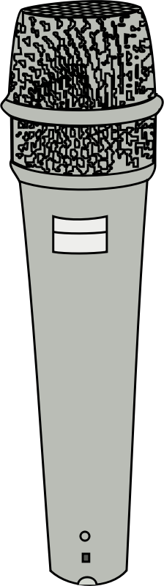

Copyright works (1)
Literary
Artistic
Musical
Dramatic
Broadcast
Sound Recording
Film

Slide 8






Copyright works (2)
Typography
Public Domain
Database
Moral Rights
Performance
Non-Qualifying
Work related

Slide 9
RESTRICTED ACTS
These are the acts that are restricted to the copyright owner only
If someone carries out a restricted act without the permission of the copyright owner (e.g., a licence, to be covered in more detail later), or as permitted in law (I cover exceptions later), they are said to have INFRINGED the copyright
The copyright owner can then sue for damages in a civil court case; in a few circumstances, infringement can lead to criminal penalties
NB The terms “piracy”, and “theft” are often used. The former is perjorative but is in common parlance for large-scale infringement. The latter is inaccurate in law and should be avoided!

Slide 10




Copyright usages – RESTRICTED ACTS
Copying
Issuing copies to the public
Renting or lending to the public
Performing, showing or playing in public
Communication to the public, e.g., placing on a Web site
Adaptation
FOR RENT

Slide 11
THE ‘PUBLIC”
Note that this can include a small sub-set of the public, e.g., a group of students, or you lot!

Slide 12
WHAT IS A LICENCE?
NORMALLY, written permission from the © owner to A THIRD PARTY ALLOWING THEM TO do one or more restricted acts
May cost money – for example, the various e-books and e-journal licences taken out by A library
Some licences may be implied, for example stuff put up on social media, but caution required - double check

Slide 13
Why consider types of
Copyright licence?
First point of call
  Can effectively provide zero risk
  May already have paid for them
They nearly all involve limitations
  Not a carte blanche so may need to check wording
  Relationship with exceptions

Slide 14
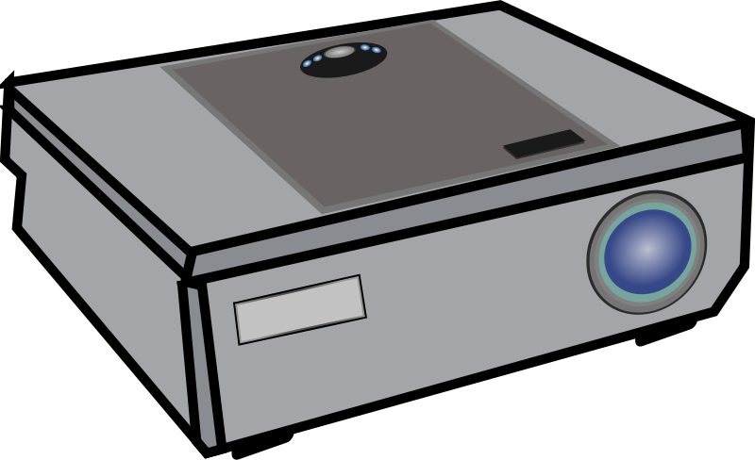


Copyright licences (1)
Copyright Licensing Agency
CLA (Copyright Licensing Agency)
NLA Media Access
ERA (Educational Recording Agency)
Filmbank / MPLC
Library E-resources (often based on JISC’s standard terms)
Creative Commons / Open Licences
Newspaper Licensing Agency
Educational Recording Agency

Slide 15


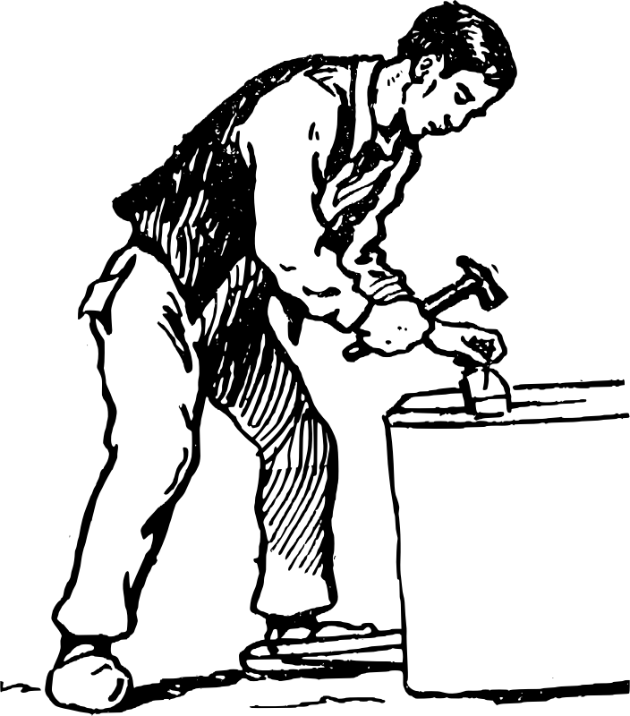

Copyright licences (2)
‘Bespoke’ permission
Website Terms and Conditions
IPO Orphan Works Licensing Scheme (discussed later)
You made it yourself
You work for / in collaboration with rights holder
Licence related

Slide 16
exceptions
This is where there have been some important recent changes to the law

Slide 17

Fair dealing
Determines whether usage is lawful or infringing based on how a ‘fair minded and honest person’ would deal with the work.
Does using the work affect the market for the original work? Does it affect or substitute for the normal exploitation of the work.
Is the amount of the work taken reasonable and appropriate? Was it necessary to use the amount taken?
N.B., rules like “one chapter from a book, or 5% of a total work is OK” generally have no legal basis. Only a Court can decide if usage was fair or not.

Slide 18


Research and Private Study – S.29
Allows individuals to make normally a single copy of limited extracts of copyright works for non-commercial research or private study. No contractual override.
Before 1 June 2014
After 1 June 2014
Non-commercial
Literary, dramatic, musical and artistic works only
Contractual terms can override exception
Non-commercial
All copyright works, including sound recordings and films
No override by contract
Updated

Slide 19

Text and Data Mining – S.29A
New exception, allows copying and downloading of large volumes of text or data for analytical purposes
Use of algorithms to determine trends/relationships
Non-commercial use
Requires legitimate subscription/access to text/data
No contractual overrides, but © owner may impose technical limitations (e.g., “you must use my API”, or “don’t download more than 1000 items a day”) if it can argue other use will adversely affect their systems. Grey area, may lead to a Court case sooner or later
At present, UK only. EU is considering introducing a Directive to permit this in other countries.
New

Slide 20


Quotation (Criticism and Review) – S.30
Allows ‘fair dealing’ usage of quotations for any purposes including ‘criticism and review’. No contractual override.
Before 1 October 2014
After 1 October 2014
Criticism & review does not cover ‘illustrative’ use
Works must already have been made publicly available
Widened to cover any reasonable quotation, legitimising academic practice
Must have been made publicly available
Updated

Slide 21


Copying for disabled users – S.31 A & B
Allows copying to provide equal access to copyright works for users with any type of physical or mental disability. On either an individual (S.31A) or institutional (S31.B) basis. No contractual override.
Before 1 June 2014
After 1 June 2014
Restricted to people with visual impairments only
Literary, dramatic, musical or artistic work
Contractual override
Widened to all impairments which prevent equal access
All types of copyright work
No contractual override
Doesn’t address DRM/TPM measures
Updated

Slide 22

Illustration for instruction – S.32
Allows limited, non-commercial ‘fair dealing’ use of copyright material for the purposes of teaching. No contractual override.
Before 1 June 2014
After 1 June 2014
Non-reprographic copying of literary, dramatic, musical and artistic works only
Wide examination exception (not music)
No sound recording/film exception
Acknowledgement required if practical
Must be fair dealing
Copying can be reprographic
Examination exception narrowed? ☹
Covers all copyright works including sound recordings, films and broadcasts
Acknowledgement required if practical
New

Slide 23

Recording of Broadcasts – S.35
Allows recording of off-air broadcasts by or on behalf of educational establishments for non-commercial purposes. Only applies where no licensing scheme (i.e., ERA) available.
Before 1 June 2014
After 1 June 2014
Non-commercial educational use
‘Communication to the public’ premises limitation
Dove-tails with ERA licence
Non-commercial educational use
‘Communication to the public’ off premises via secure electronic network
Dove-tails with ERA licence
Updated

Slide 24
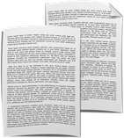
Educational Copying and Use of published Extracts - S.36
Allows copying and use of multiple copies of extracts from published copyright works. Only applies where no licensing scheme (i.e., CLA) available.
Before 1 June 2014
After 1 June 2014
Non-commercial
≤1% per work, per quarter, per institution
Covers typographical arrangement
Dove-tails with CLA licence
Very limited use
Non-commercial
≤5% per work, per year, per institution
Includes incorporated works (e.g., illustrations)
Dove-tails with CLA licence
Still of limited use
Updated

Slide 25

Making Works Available on Dedicated Terminals – S.40B
New exception
Relates to a publicly accessible library, educational establishment, museum or archive
Allows collection items to be digitised and viewed on site through ‘dedicated terminals’
Works must have been lawfully acquired
For research or private study
Access must be compliant with licensing terms if they exist
New

Slide 26

Library Copying for
Other Libraries – S.41
Allows supply of copies of the whole or part of any published work from one library to another. No contractual override.
Before 1 June 2014
After 1 June 2014
Supply of a journal article or whole or part of literary, dramatic or musical work
Includes illustrations in context
Contractual override
Supply of journal article or whole or part of any published work
Will include sound recordings, films and broadcasts
No contractual override
Updated

Slide 27

Preservation – S.42
Allows libraries, archives and museums to make copies of items in their permanent collection. No contractual override.
Before 1 June 2014
After 1 June 2014
Single copy of item in permanent collection
Literary, dramatic or musical work
Includes illustrations and typographical arrangement
Contractual override
Copy an item in permanent collection
All types of copyright work including sound recordings, films and broadcasts
Items not publicly accessible or available on loan
No contractual override
Updated

Slide 28

Library Copying for
Patrons – S.42A
Allows libraries to make a single copy of reasonable proportion of copyright works for their patrons, or for patrons of a different library, for non-commercial research or private study.
Before 1 June 2014
After 1 June 2014
‘Prescribed’ libraries
Non-commercial research or private study
Article in a periodical or part of literary, dramatic or musical work
Declaration form
Patron must pay cost of supply
Contractual override
Not-for-profit library
Non-commercial research or private study
Reasonable proportion of any copyright work
Declaration still required but not through set form
Patron does not have to pay cost of supply
No contractual override
Updated

Slide 29

Library Copying of Unpublished Works – S.43
Allows librarians to make a single copy of whole or a part of an unpublished work for their patrons for non-commercial research and private study.
Before 1 June 2014
After 1 June 2014
Literary, dramatic or musical works only
Copyright holder must not have prohibited copying
Single copies only may be provided
All types of copyright work
Copyright holder must not have prohibited copying
Single copies only may be provided
Updated

Slide 30
Orphan works Exception
Orphan Works = works where the rights holder is unknown or untraceable.
Previously required a ‘risk-managed’ approach. Now:
  UK Orphan works Licensing Scheme
  EU Orphan Works Directive 2012/28/EU
Implemented in the UK on 29 October 2014
New

Slide 31
Orphan Works
UK licensing scheme
Orphan works exception
Covers all types of Orphan Work (including photographs)
Commercial and non-commercial use
Anyone can take a licence out – though few have done so; complaints about expense
Requirement for reasonable searches
Operated by the IPO
7 year licence term / UK only
Covers all text and audio visual works (but not artistic unless embedded)
Non-commercial use
Applies to cultural and educational organisations
Reasonable searches recorded on a database
No geographical restriction or time limit

Slide 32

Credits
Some of the original slides were (apart from any images contained within) © Chris Morrison (@cbowiemorrison) 2015 and were available for reuse under a Creative Commons Attribution, Non-Commercial, Share Alike 4.0 licence. Description of copyright exceptions is © University of Kent 2014 and used under the terms of a Creative Commons Attribution 4.0 International licence
Amendments to the slides have been made by me! (Charles.Oppenheim@northampton.ac.uk)
Clip Art icons are from openclipart.org

Slide 33
TIME FOR Q & A?

