Slide 1
Flipping NILE Guides
Iain Griffin | Learning Technologist

Slide 2
NILE
Northampton Integrated Learning Environment

Slide 3
Learning Technology
Support and training for teaching technologies

Slide 4
HELP!

Slide 5
One year ago….

Slide 6
A to Z

Slide 7
MyPad

Slide 8
The Solution (part 1)
Frequently Asked Questions

Slide 10
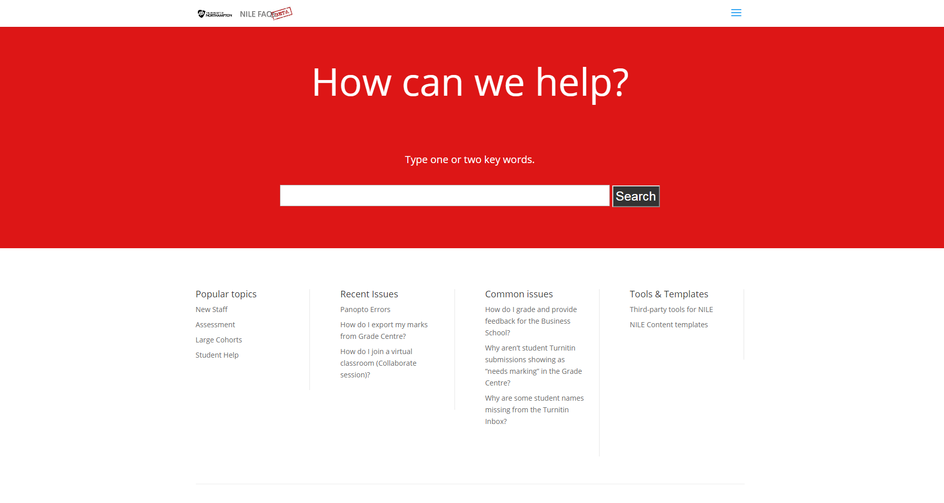

Slide 11
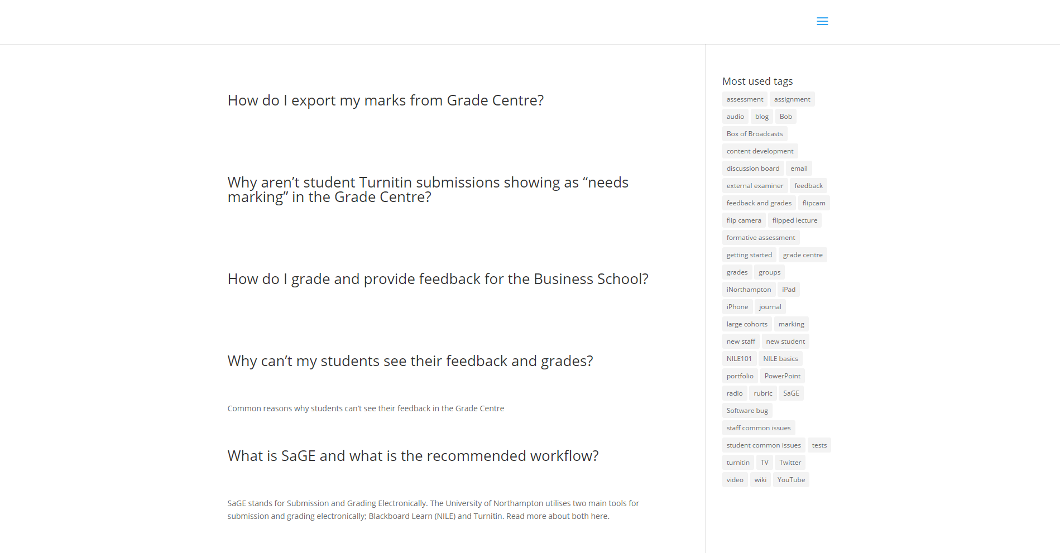

Slide 12
No

Slide 13
The Solution (part 2)
Task-based enquiries

Slide 14
MyPad
Search

Slide 15
Task = Tool
Not Tool = Task

Slide 17
‘I want to…’

Slide 18
Theme > Approach > Method > Tool

Slide 19
Assessment > Written > Essay > Turnitin

Slide 20
Themes >
Communication
Assessment
Content

Slide 21
Themes > Approach
Poster
Multimedia
Reflective Journal
Work-based Learning
Critical Incident Account
Traditional Exam
Open-book/notes Exam
Structured & Multi-choice Exam
Viva / Oral Exam
Essay
Report
Review and Annotated Bibliography
Dissertation & Theses
Project
Practical
Portfolio
Presentation

Slide 22
80 / 20
‘Most people, most of the time’

Slide 23
Assessment > Written > Essay > Turnitin
Similarity report – to help detect plagiarism
Quickmarks – to help you highlight common mistakes
In-line marking – to help you pinpoint feedback within a paper
Audio or written feedback – to allow you to choose your preferred method
Rubrics – to help with consistent marking

Slide 24
Click... Click

Slide 25
Self-produced guides
University workflow
School workflow

Slide 26
Themes >
Communication
Assessment
Content

Slide 27
Theme > Approach > Method > Tool

Slide 28
Communication
Time
Live (synchronous)
Not live (Asynchronous)
People
Single person
Group
Whole cohort

Slide 29
Communication
Synchronous
Peer-to-peer
Collaborate

Slide 30
Themes >
Communication
Assessment
Content

Slide 31
Theme > Approach > Method > Tool

Slide 32
Content >
Find
Design
Create

Slide 33
The Result
NILE Guides

Slide 35
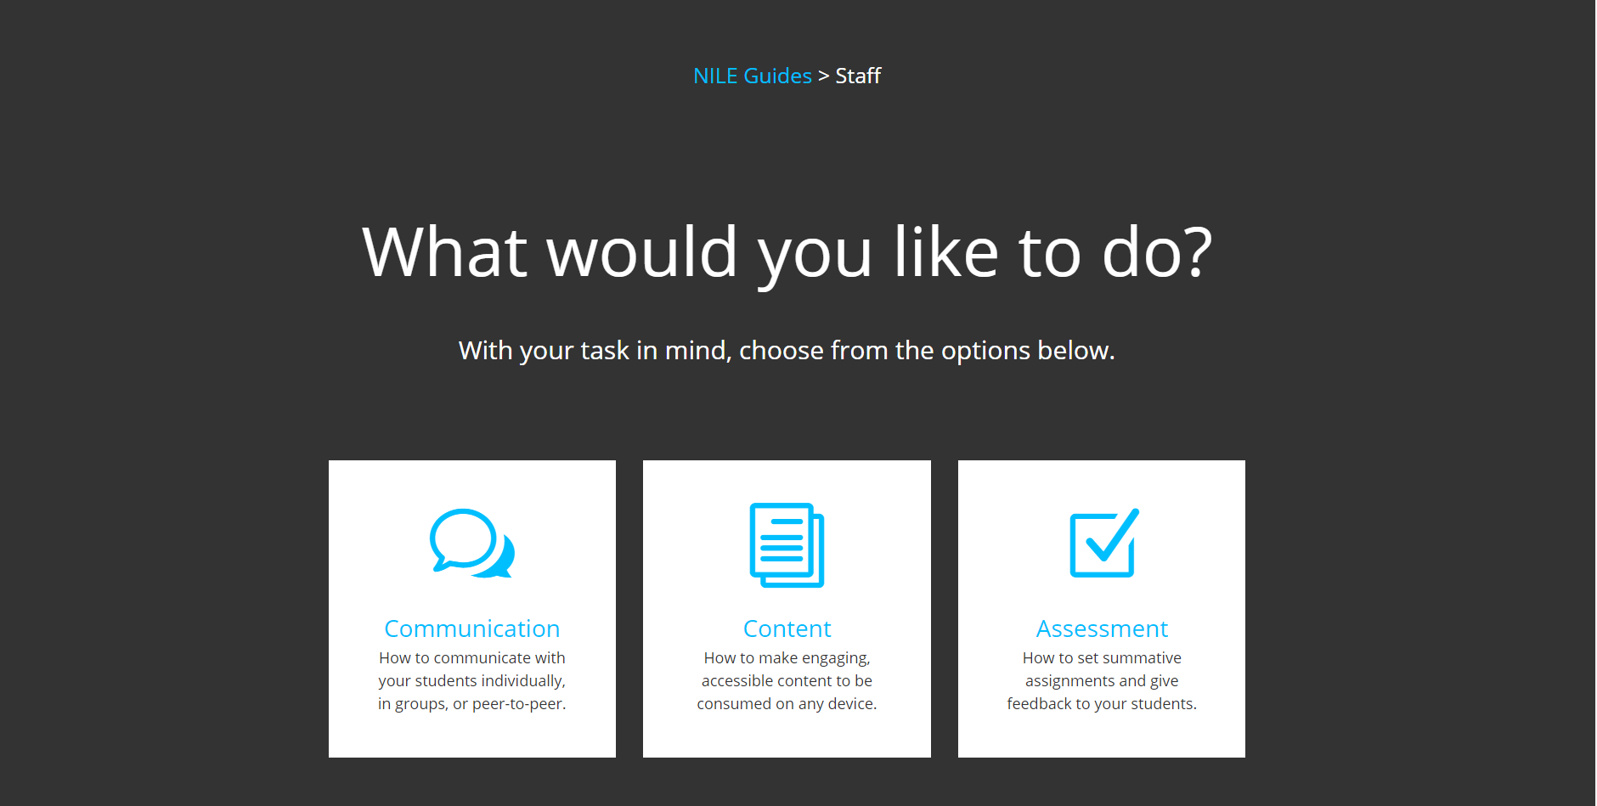

Slide 36
Impact
So far...

Slide 38
What next?
Future development & research

Slide 39
Future developments
NILE Guides
Student section
Further staff guides
NILE FAQs
Redesigned look
Timely announcements
Review stats and feedback

Slide 40
Thank You
Any questions?

Slide 41
mypad.northampton.ac.uk/nilehelp

