Slide 1
The App : Learning development, a mobile future
By Kate Swinton

Slide 2
Mobile app
Why?
How
Impact

Slide 3
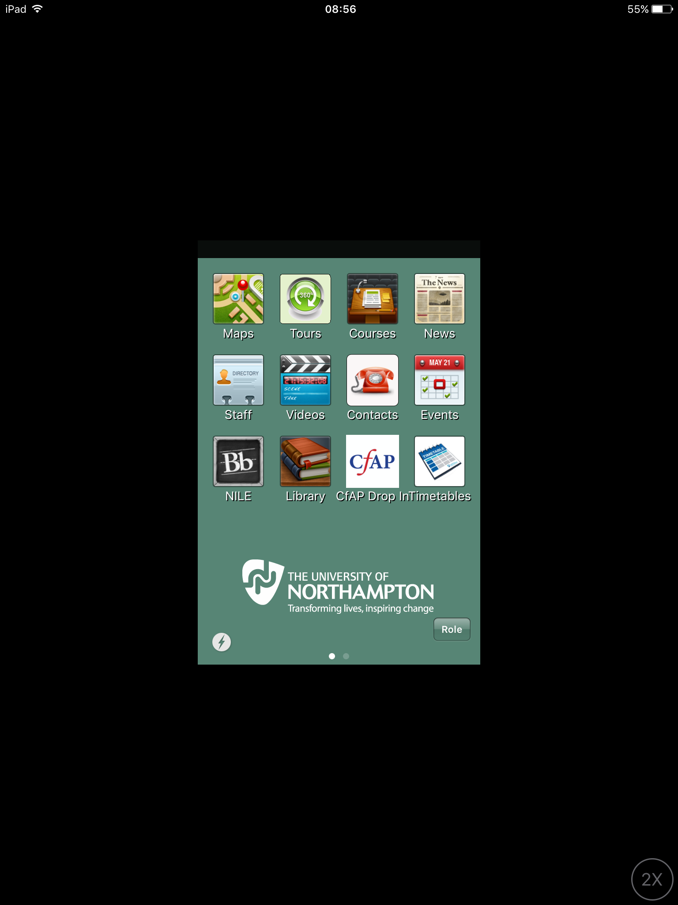

Slide 4
Impact
44% increase over all
49% increase in males under 21
58% increase in white males under 21
57% increase in first year students
29% increase in students with a disability

