Slide 1
Application of gamification principles to enhance delivery of research methods principles within Podiatry
Rob Howe, Anne Misselbrook and Mike Curran
The University of Northampton
Presentation at LLS Conference – 5th July 2016
Notes:
Welcome and introductions

Slide 2
Why?
Traditionally Research Methods is difficult topic for Podiatry students to understand
Student engagement was variable
Evidence that students did not apply the Research Methods topics
“My reason for doing this is to try and look at alternative ways of delivering a potentially dry subject, with ability for the students to reflect on the statistics at a future date.” Mike Curran.
Gamification is the application of game-design elements and game principles in non-game contexts

Slide 3
Some benefits for students
Accessible all the time.
A good revision tool.
Short chunks of content on page – accessible without scrolling.
Supports and motivates learners (Koivisto et al, 2014)
Creates a ‘flow’ into the materials
Enhances digital skills

Slide 4
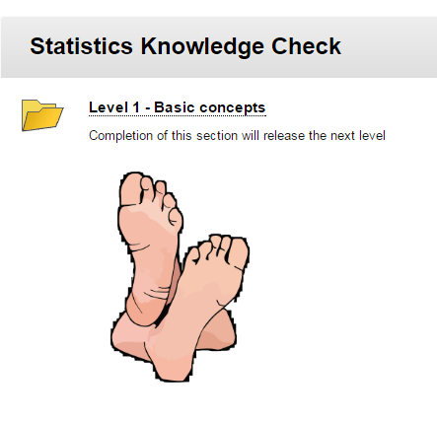
Demo

Slide 5
Is it working? Feedback from students (n=33)
What worked for the students:
Navigation
Useful resource
Great way to revise
Accessible all the time
Simple approach
Playback ability
Ability to revisit throughout the course
Provided humour to conclude the test.
“I found tackling the Knowledge Check in 4 separate stages hugely useful and much more manageable than being exposed to a larger test. I found the separate stages less intimidating”.

Slide 6
Lessons learnt
What the students would have liked:
Face to face prior to the online session
Hints for correct answer
Feedback on why answers were wrong
More context regarding statistics at the beginning and a link to further reading
More basic introduction before the release of the content
Higher quality video with content referring to Podiatry and a summary
Subtitles on the video to accommodate the learners

Slide 7
Top five tips
Keep it sweet and simple throughout.
Cater for mixed ability and start at a low level
Gradual release of content.
Add relevant humour where appropriate.
Be prepared to try new methods of delivery

Slide 8
Final comment from tutor
“It is interesting to me how to blend the concept of e-packages with actual face to face teaching.
I guess it is the future.”
Mike Curran

Slide 9
What was the reward video?
https://www.youtube.com/watch?v=lDRrbHJZU1s

Slide 10
Questions?
Contact details:
Rob Howe
Rob.Howe@northampton.ac.uk
01604 892483
Anne Misselbrook
Anne.Misselbrook@northampton.ac.uk
01604 893596

Slide 11
References
Enterprise Gammification Consulting (2015) "Gamification Design Elements". [http://www.enterprise-gamification.com Retrieved 18-2-2016.]
Huotari, K., & Hamari, J. (2012). "Defining Gamification - A Service Marketing Perspective" (PDF). Proceedings of the 16th International Academic MindTrek Conference 2012, Tampere, Finland, October 3–5.
Koivisto, Jonna; Hamari, Juho (2015). "Demographic differences in perceived benefits from gamification". Computers in Human Behavior 35: 179–188. doi:10.1016/j.chb.2014.03.007.
Misselbrook, A., Howe, R., Curran, M., (2016) Dr Michael Curran uses a gamification approach with online tests. [http://blogs.northampton.ac.uk/learntech/2015/11/17/dr-michael-curran-uses-a-gamification-approach-with-online-tests/. Retrieved 18-2-2016].
Robson, K., Plangger, K., Kietzmann, J., McCarthy, I. & Pitt, L. (2015). "Is it all a game? Understanding the principles of gamification". Business Horizons 58 (4): 411–420. doi:10.1016/j.bushor.2015.03.006.
Sebastian Deterding, Dan Dixon, Rilla Khaled, and Lennart Nacke (2011). From game design elements to gamefulness: Defining "gamification". Proceedings of the 15th International Academic MindTrek Conference. pp. 9–15.

