Slide 1
Early Years ICT
“Gaining understanding of digital technologies and systems and using them in a purposeful way to solve problems and communicate ideas”
Notes:
Overview of the module, booklet and assessment
Curriculum Changes and new POS

Slide 2
Session 1: Presentation Tools and Digital Storytelling
The role of presentation software and digital story telling in the Early Years
Exploring techniques
Creating and sharing a resource
Notes:
Blogs and ResourceBank
Browsing and Reading (to select from)
Play in Education: www.theguardian.com/teacher-network/teacher-blog/2013/feb/27/play-education-creative-learning-teachers-schools
Learning, Digital Media and Creative Play in Early Childhood: http://spotlight.macfound.org/featured-stories/entry/learning-digital-media-and-creative-play-in-early-childhood/
The use of digital literacy tools on the iPad to change pedagogy:
A case study of how a sequence of tools support a classroom project mrandrewsonline.blogspot.co.uk
Presentation tools: http://ictwithmissc.weebly.com/presentation-tools.html
Animoto: http://www.slideshare.net/beenaraichura/animoto-for-the-classroom-12303409
Digital Storytelling Inside PreK: http://blogs.preknow.org/insideprek/2008/03/digital-storyte.html
Sample EY activity combining photos, text and sounds: http://www.risingstars-uk.com/uploads/publications/987.pdf
What’s Your Story? Creating and Connecting with Digital Stories in the Early Years http://www.classroom20.com/forum/topics/what-s-your-story-creating-and-connecting-with-digital-stories-in
The Fairytale Travel company http://roydon21classes.blogspot.co.uk/2013/05/the-fairytale-travel-company.html
Make a visual representation of a poem
Literacy webtools: http://ictwithmissc.weebly.com/writing.html , http://ictwithmissc.weebly.com/reading1.html , http://ictwithmissc.weebly.com/spelling--grammar.html
NightZookeeper missions for drawings and stories: https://dl.dropboxusercontent.com/u/24940764/Teleporting%20Torch%20lesson%20plan%20and%20resources.pdf

Slide 3
Background
Why do we tell stories?
How can we use tech tools to enhance storytelling?
What are the essentials for telling a 'good' story?
What are other ways we can tell stories using digital media?
Notes:
Stories are a natural way of sharing and communicating
The use of technology to create and share can enhance this process.
Technology as means to play, not supplanting play, but extending and supporting play
Children actively engaged in authentic interactions with their world
“When adults are talking to children about what they’ve seen, what they’ve heard, and children get assistance in their ability to process it, that’s when it’s the most valuable.” - See more at: http://spotlight.macfound.org/featured-stories/entry/learning-digital-media-and-creative-play-in-early-childhood/#sthash.869u7zta.dpuf
Share experiences of digital storytelling.

Slide 4
iPads for capturing and sharing
http://www.youtube.com/watch?v=Y5b6y7DJuYk&feature=share
Notes:
http://www.youtube.com/watch?v=Y5b6y7DJuYk&feature=share
Children keen to find ways of sharing.
Making and sharing digital artefacts.

Slide 5
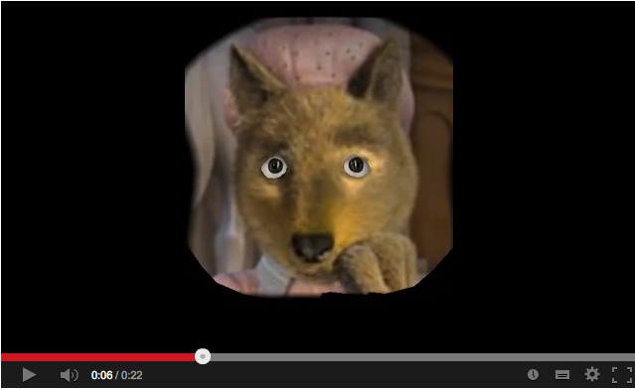
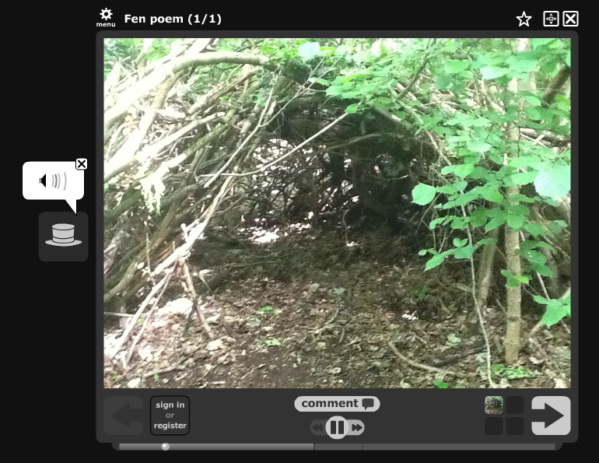
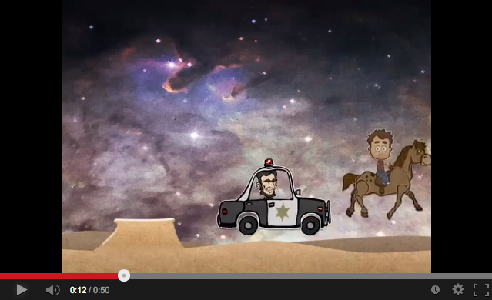
Examples
Nightzookeeper online and an app
https://dl.dropboxusercontent.com/u/24940764/Teleporting%20Torch%20lesson%20plan%20and%20resources.pdf
Retelling tales with Morfo
http://www.youtube.com/watch?feature=player_embedded&v=oHlt-b5MDA0
Puppet Pals storytelling in Year 1
http://www.youtube.com/watch?v=7t2aps_RgG4
Voicethread: http://voicethread.com/#q.b3231337.i17119834
Notes:
https://dl.dropboxusercontent.com/u/24940764/Teleporting%20Torch%20lesson%20plan%20and%20resources.pdf
http://animals.nightzookeeper.com/
Use online or as an app and use as the basis for storytelling/layering apps
http://roydon21classes.blogspot.co.uk/search/label/digital%20storytelling

Slide 6
Using Popplet for Literacy
https://vimeo.com/48685052

Slide 7
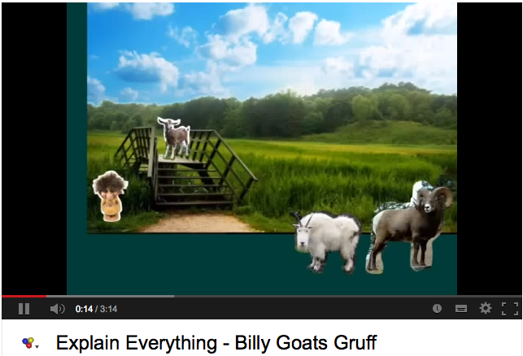
Explain Everything: Developing drama and communication
http://www.youtube.com/watch?feature=player_embedded&v=IrCpVnGff7s
http://www.mrandrewsonline.blogspot.co.uk/2013/04/explain-everything-developing-drama.html
Notes:
Mr Andrews explains a class project using the iPad app.

Slide 8
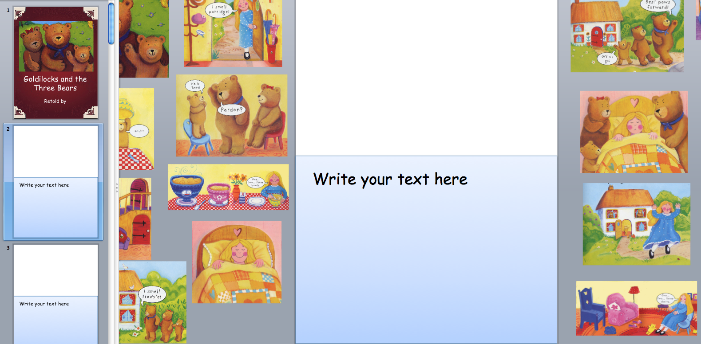
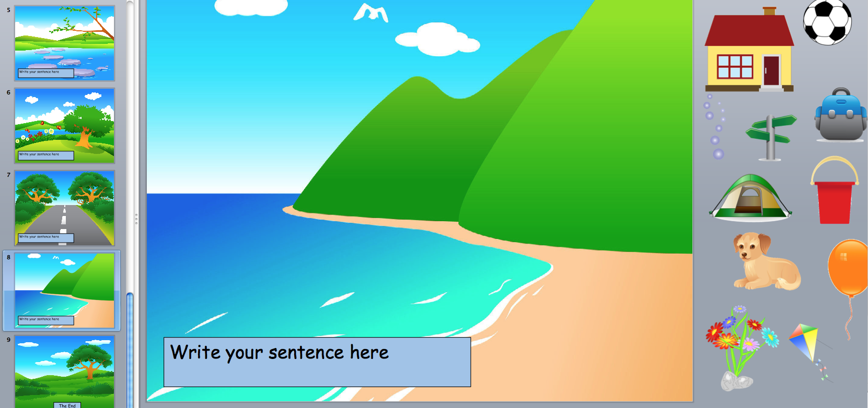
PowerPoint StoryMakers
http://www.communication4all.co.uk/http/StoryMaker.htm

Slide 9
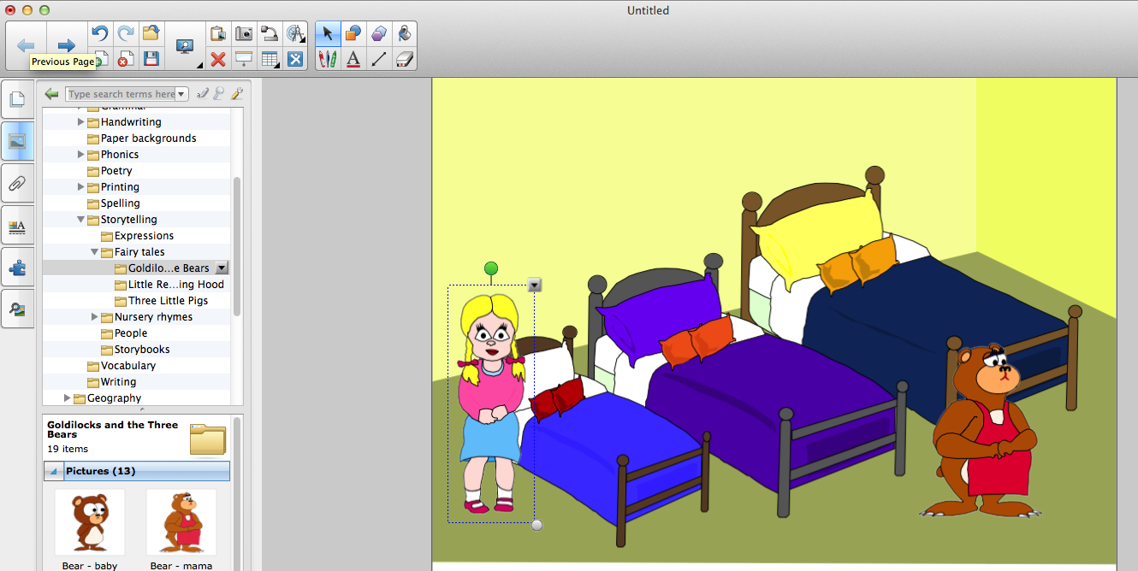
SmartNotebook tools
Gallery Essentials>English and Language Arts>Storytelling

Slide 10
Layering apps
Notes:
Using screenshots from apps to prompt storytelling: My Monsters, Create-A-Monster, Make Monster, Robot Lab, Mrs Potato Head, Make an Animal, Moody monster, Robot Lab
eBooks as a prompt: Collins Big Cat books
VoiceThread and PlayArt
PixnTell, Sonic Pics, Snapguide
Consider how to provide young children with the early technology-handling skills that are associated with early digital literacy, just as book-handling skills are associated with early literacy development.
Consider how digital technologies might be used to help bridge the gap for children with lower emergent literacy skills.

Slide 11
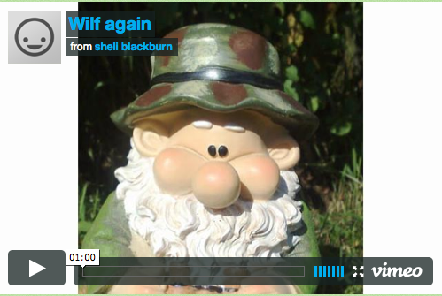
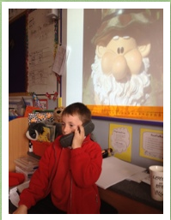
Integrating digital storytelling
http://roydon21classes.blogspot.co.uk/search/label/digital%20storytelling
http://roydon21classes.blogspot.co.uk/search/label/Fairytale%20Travel%20Company

Slide 12
How many ways can you tell a story?
Webtools
Purple Mash
StoryBird
StoryJumper
Movie Maker
Bookr
VoiceThread
Little Bird Tales
Haiku Deck
iPad apps
I can animate
Explain Everything
iMovie Trailers
Collins Big Cat Books
Strip Designer
Morfo Booth
Draw and Tell
StoryPatch
Tellagami
StoryBuddy
My Story
Videoscribe
Book Creator
Sonic Pics
Puppet Pals
Book Creator
VoiceThread
Sock Puppets
MyCreate
Little Bird Tales
Scribble my Story
PhotoCard
Software
2Create
2Create a story
Zu3D
PowerPoint
SmartNotebook
Clicker6
Tizzy’s First Tools
Notes:
Using speech-to-text software to help emergent writers capture their stories
Task: Explore ways to tell stories using presentation tools with EYFS children.
Think about classroom organisation, accessibility and equity when selecting, using and evaluating technology and media for early childhood settings.
Consider ways in which digital storytelling offers opportunities for young children to reflect upon their lives and interests through multimodal narratives.

Slide 13
Directed task
Use your blog to make a comparison of digital storytelling and presentation tools through commentary and reflection on the session. Reflect upon the theme of digital storytelling through your blog, bringing in examples and curriculum applications relevant to the EYFS classroom.

