Slide 1
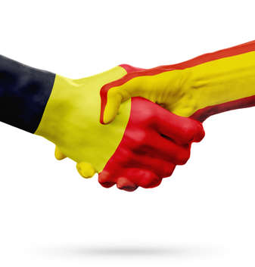
DLAB project 2022

Slide 2
Breaking environmental boundaries

Slide 3
Cryptic descriptions
Group 1
Group 2

Slide 4
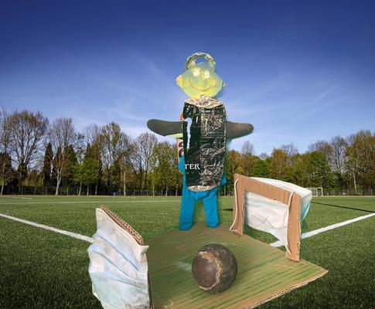
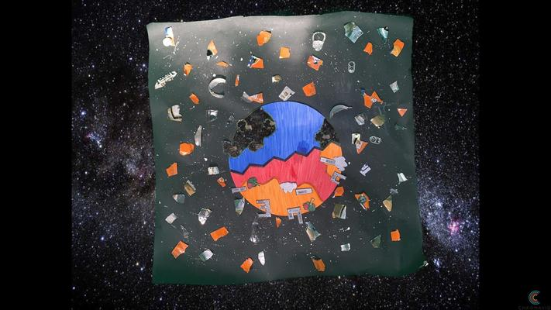
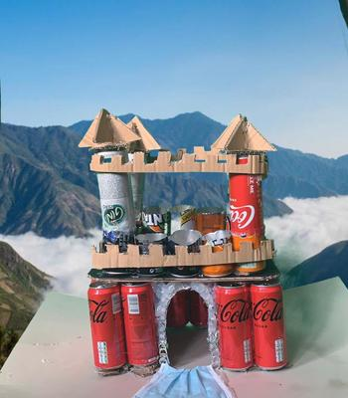
Group 1
Trash building
From trash to art

Slide 5
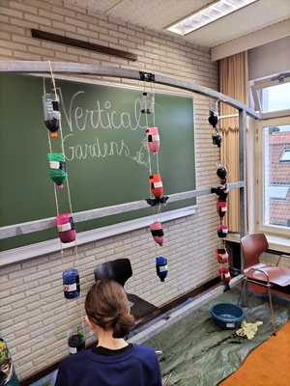
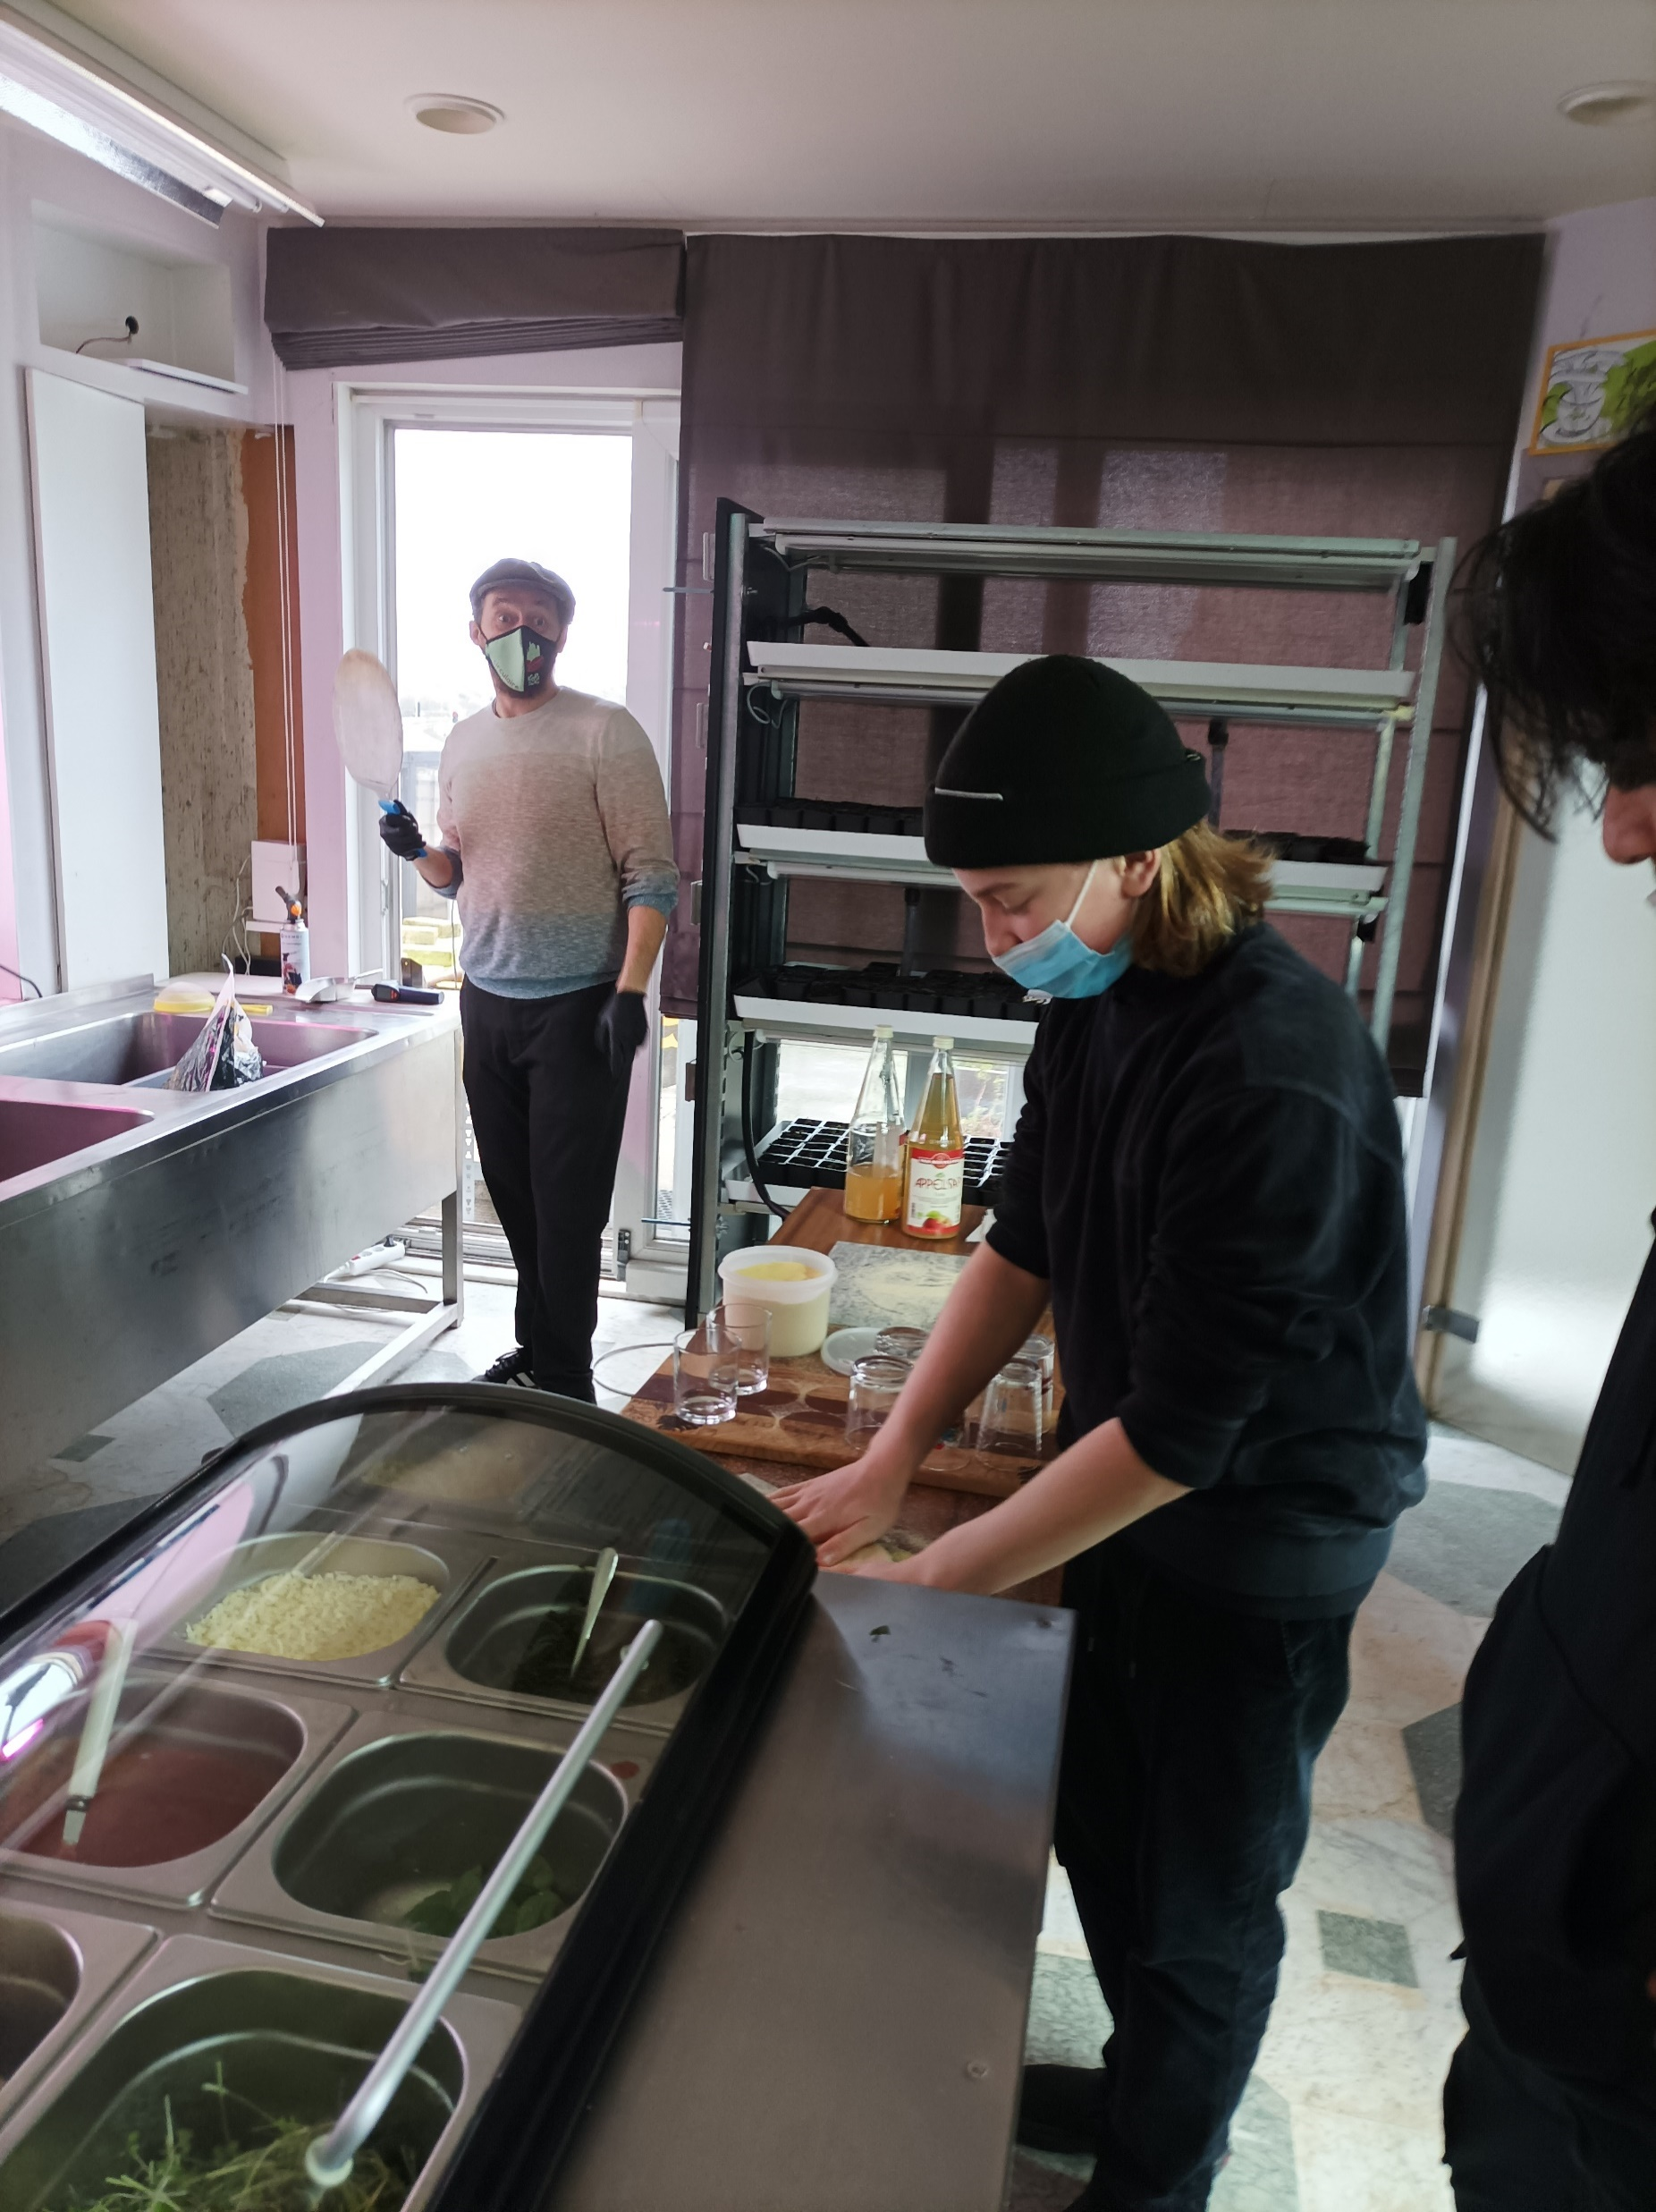
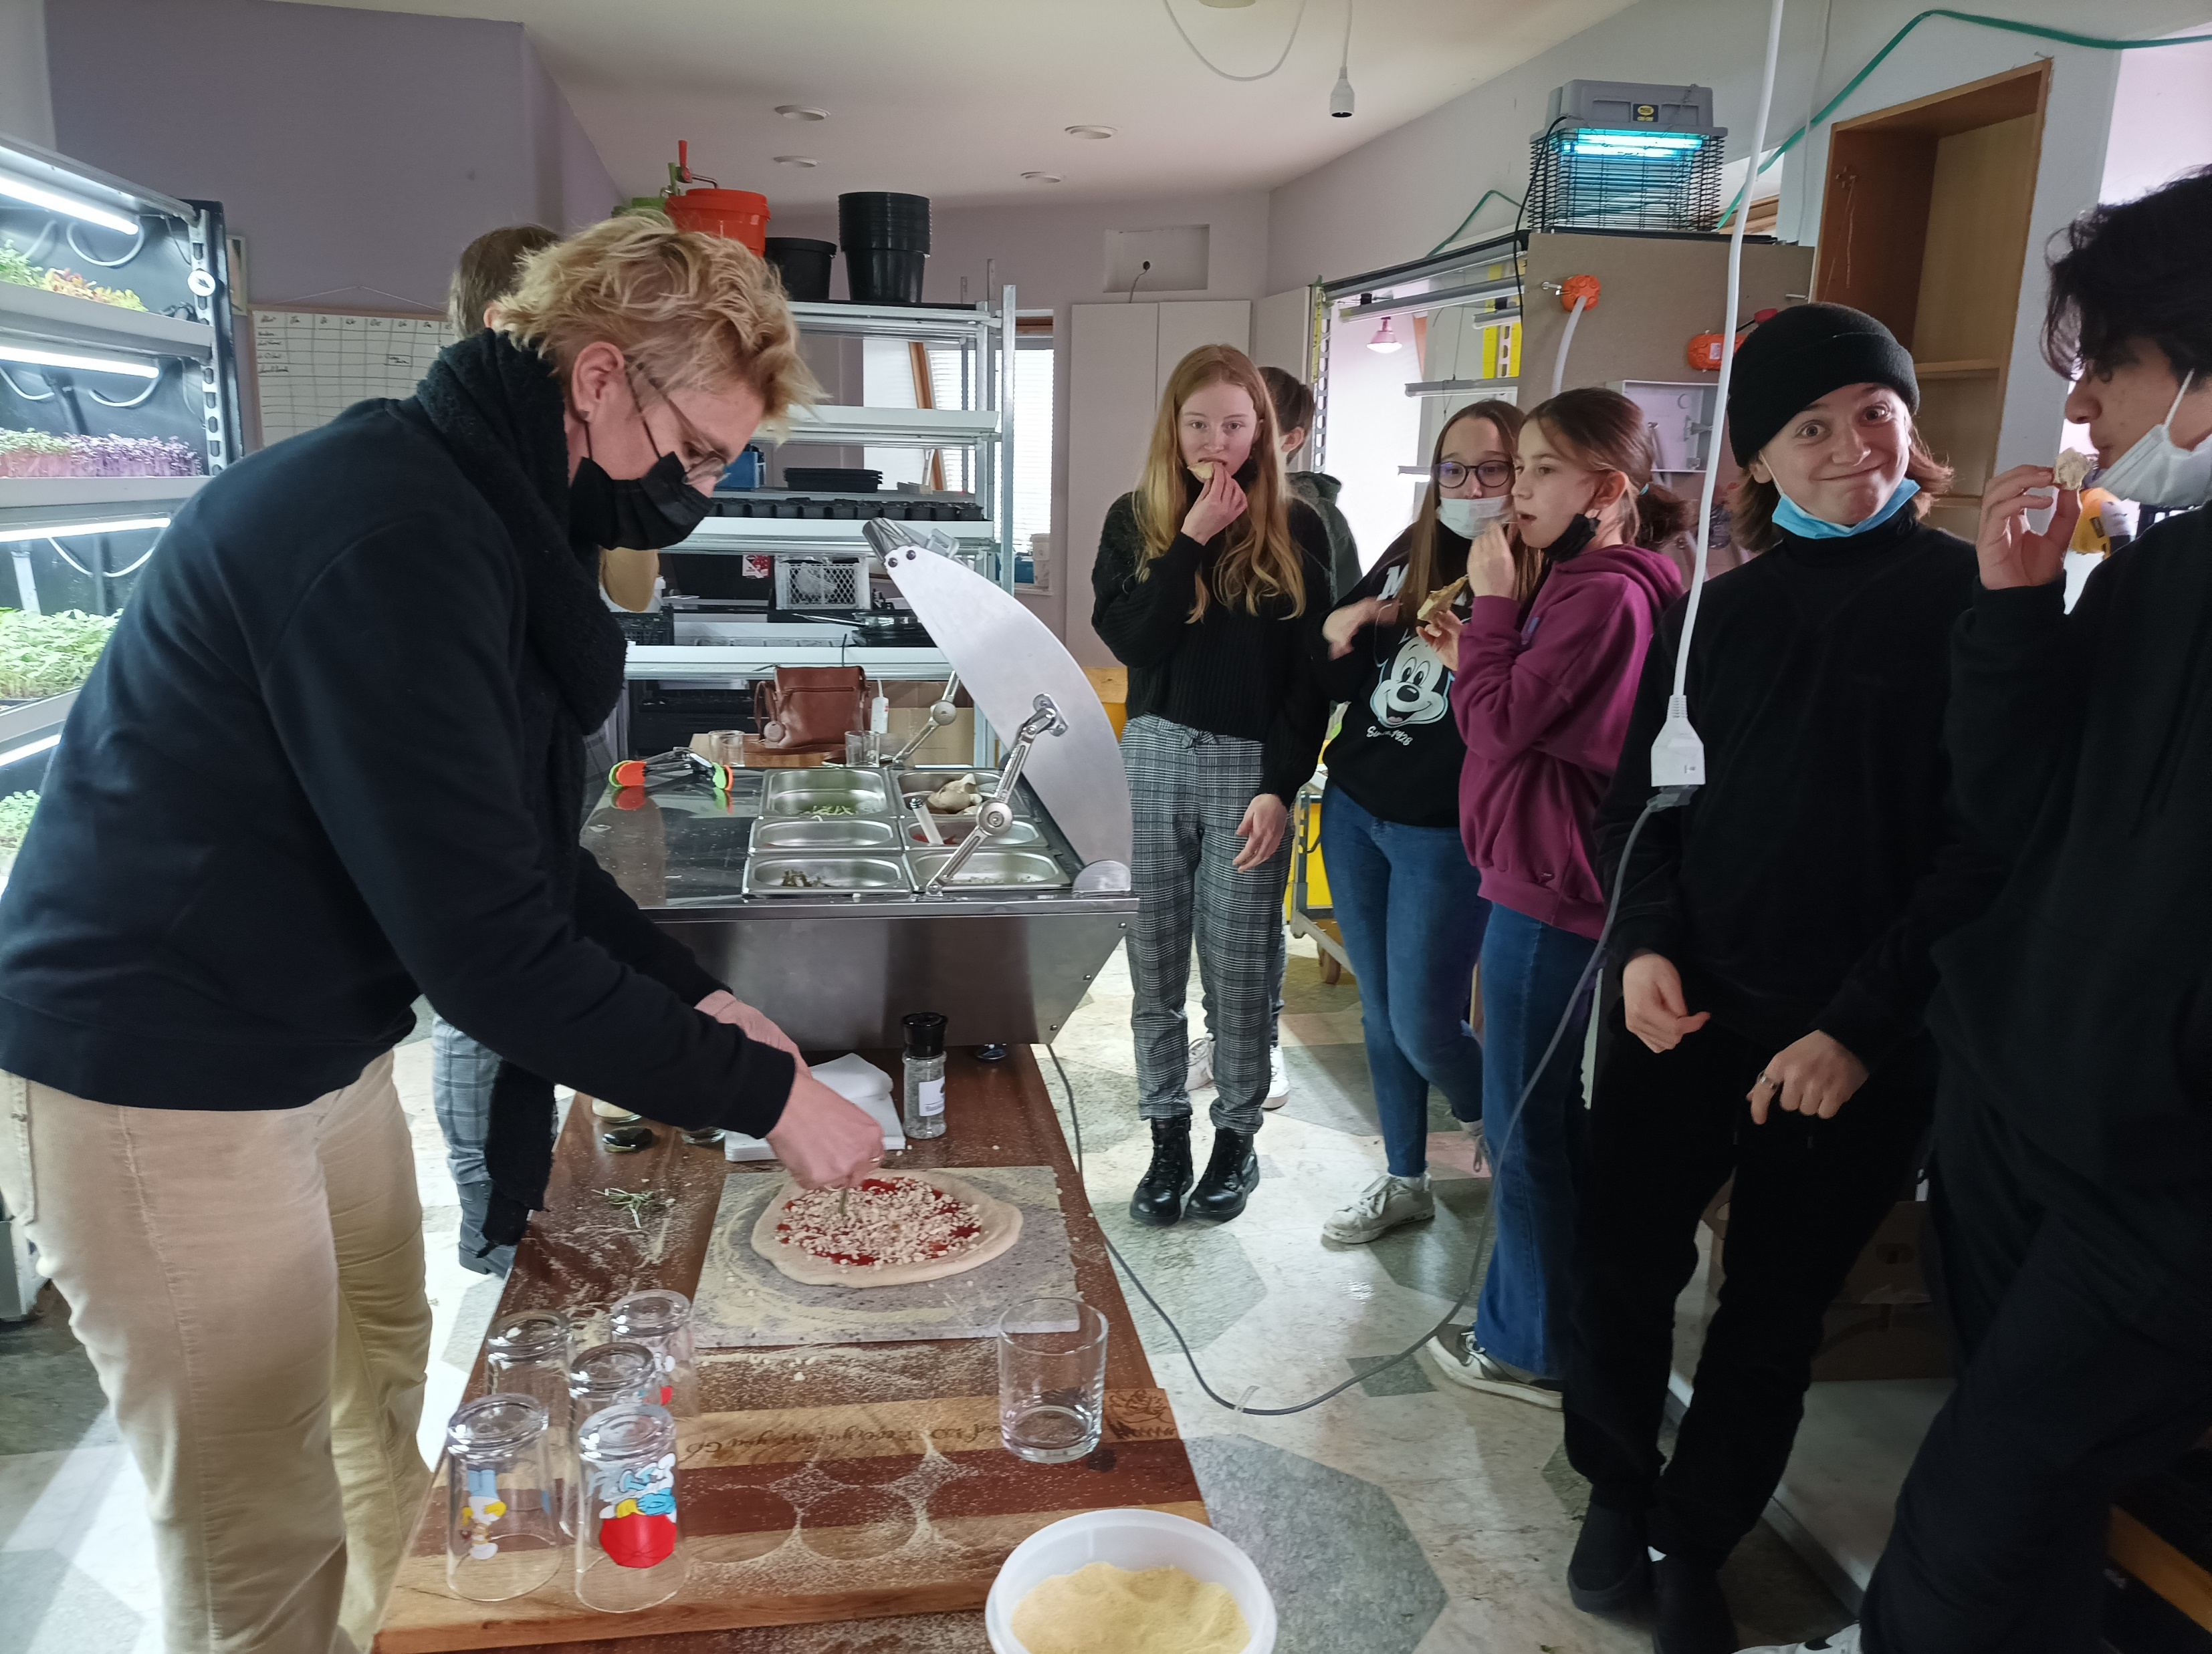
Group 2
From waste to food
Sustainable food
Vertical gardens

Slide 6
DLAB: Day 1

Slide 7
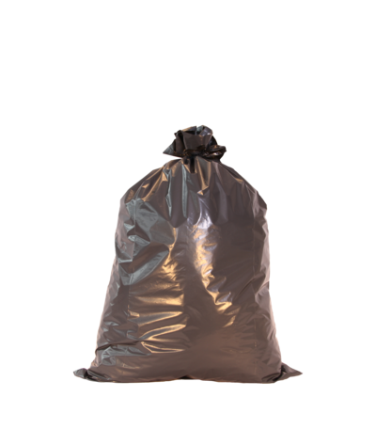
Collect trash
foto
foto
foto
foto
Bruges

Slide 8
Route via Strava
T
R
S
H

Slide 9
Our Story
Made with trash
the consequences of cigarettes
With Bookcreator

Slide 10
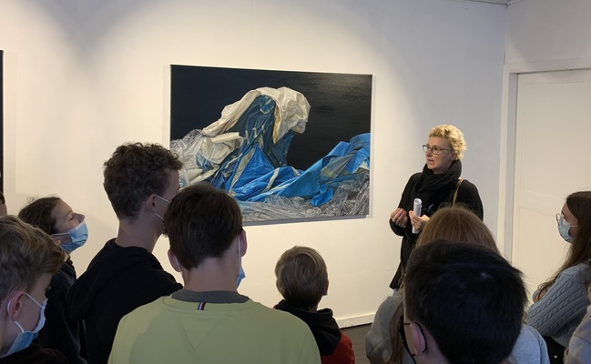
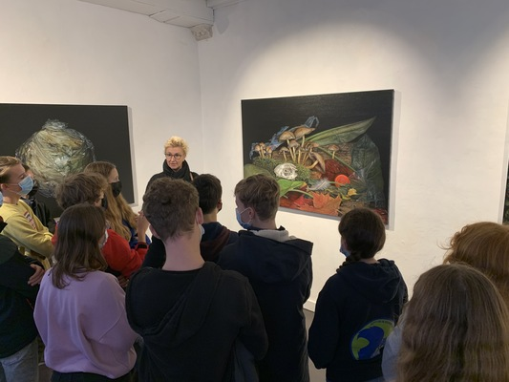
Exhibition of Cindy Wright
exhibition of Cindy Wright
Cindy Wright

Slide 11
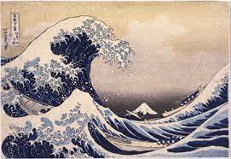
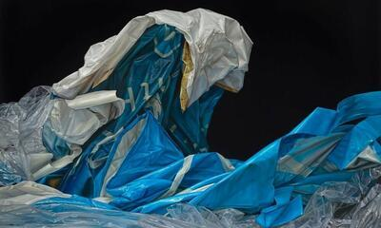
Our source of inspiration
Big wave
Cindy Wright
Hokusai's Great Wave
of Kanagawa

Slide 12
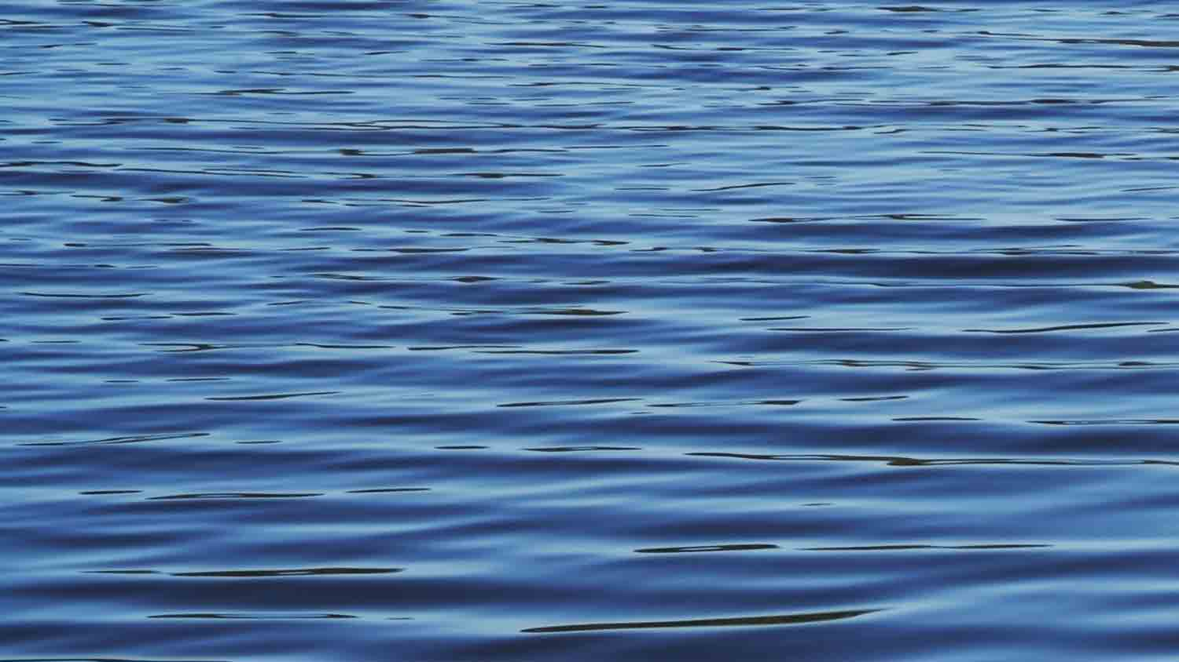
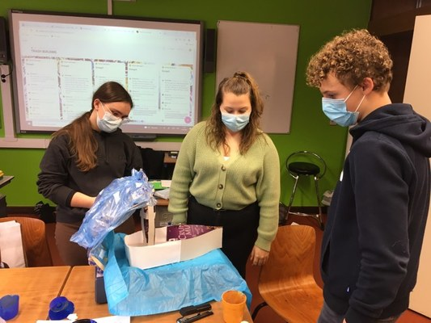
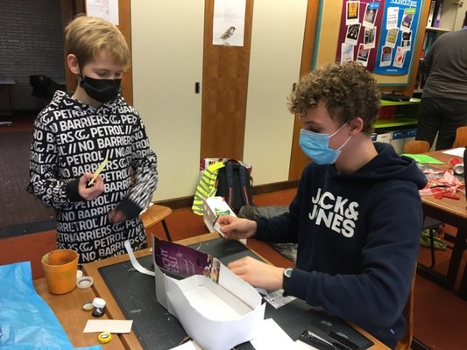
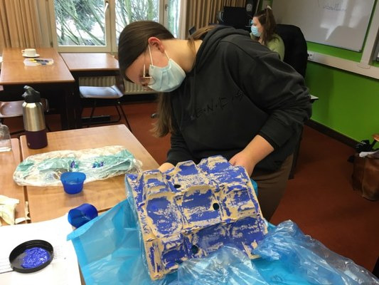
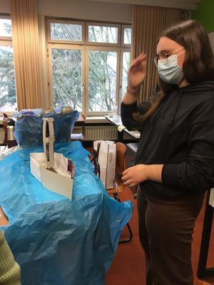
The creation process

Slide 13
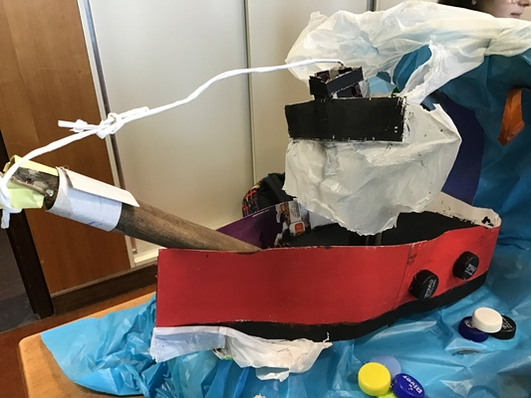
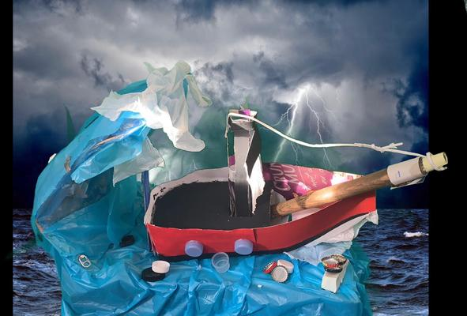
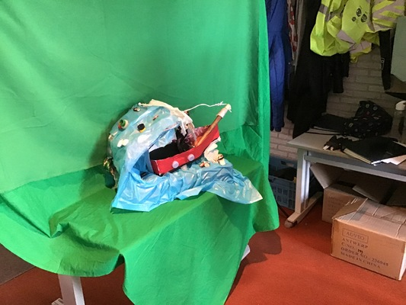
The final result

Slide 14
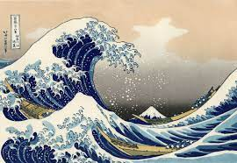
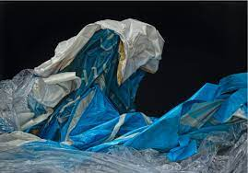
Our message

Slide 15
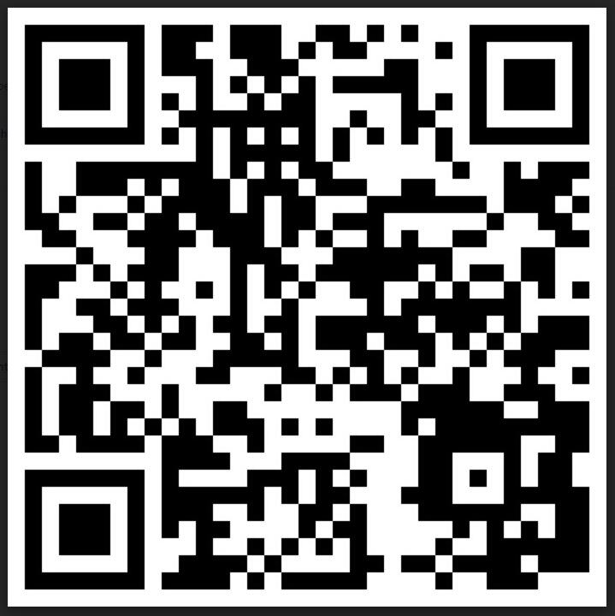
The whole DLAB project
Scan me!

